Slide 1


Slide 2
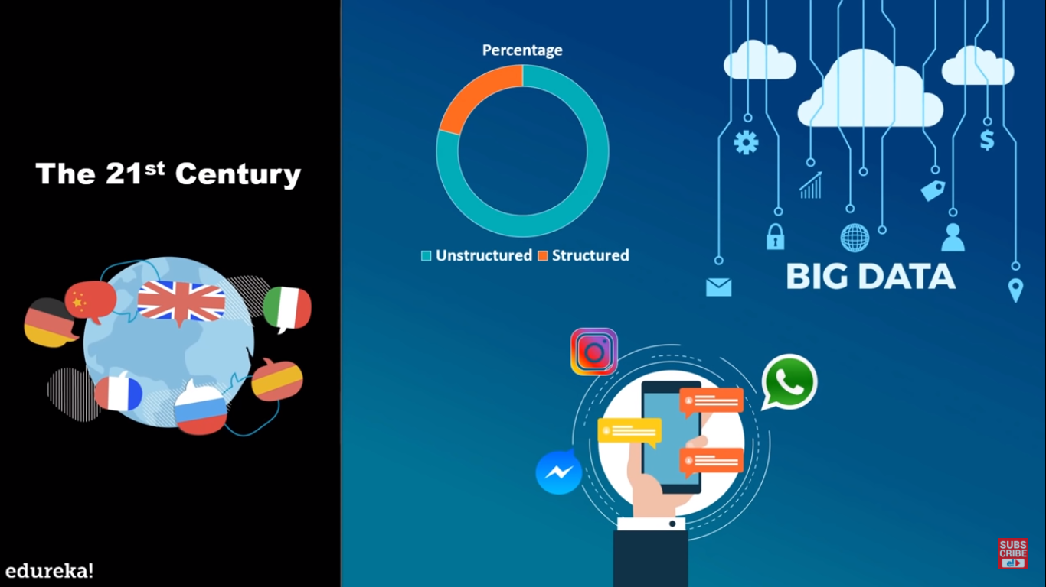

Slide 3
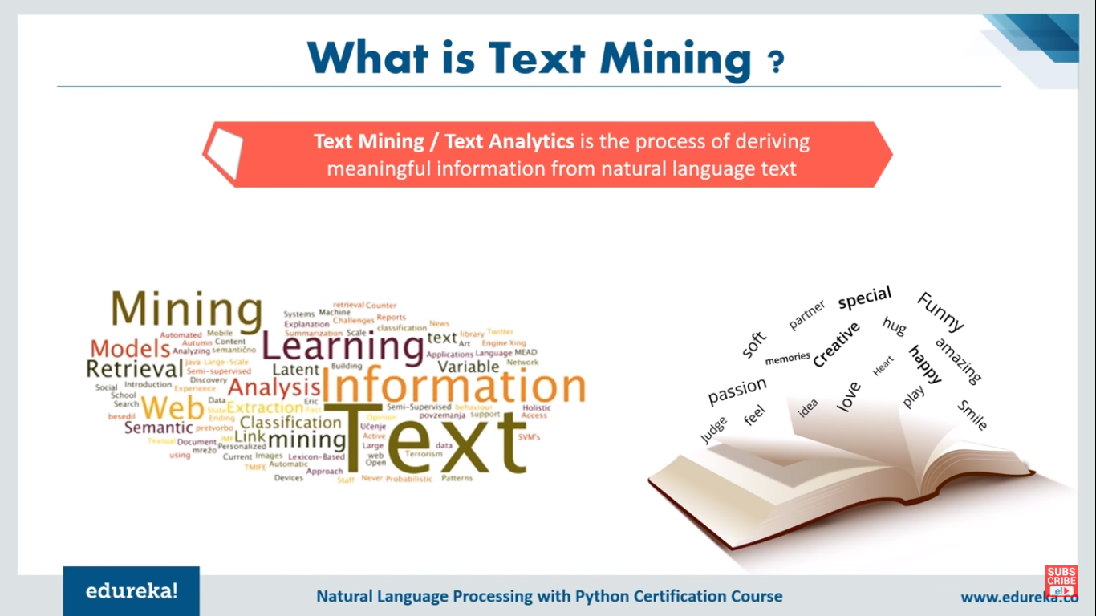

Slide 4
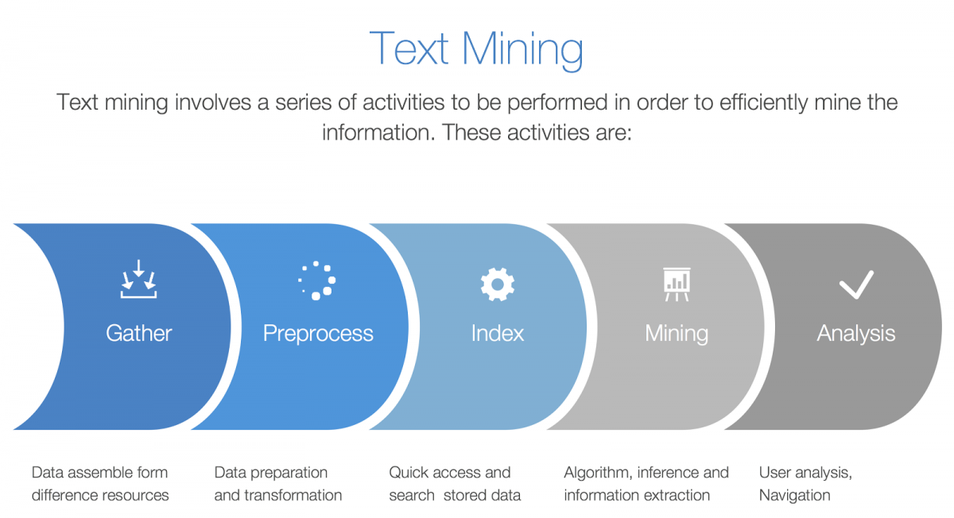

Slide 5


Slide 6


Slide 7
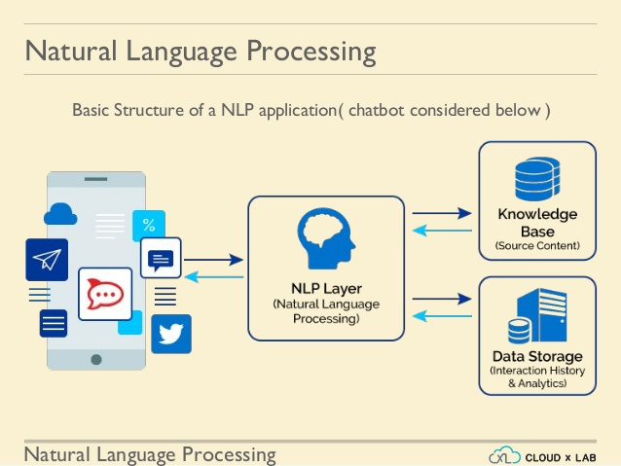

Slide 8
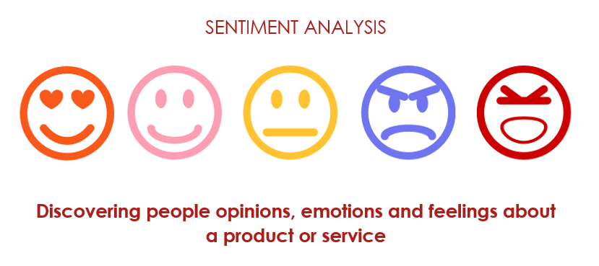


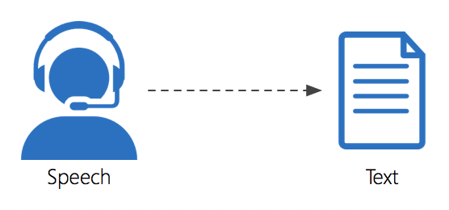

Slide 9



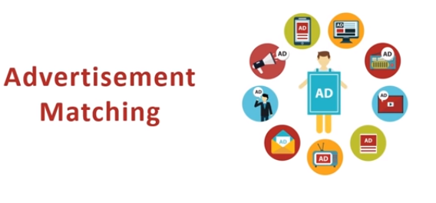
SPELL CHECKING

Slide 10


Slide 11
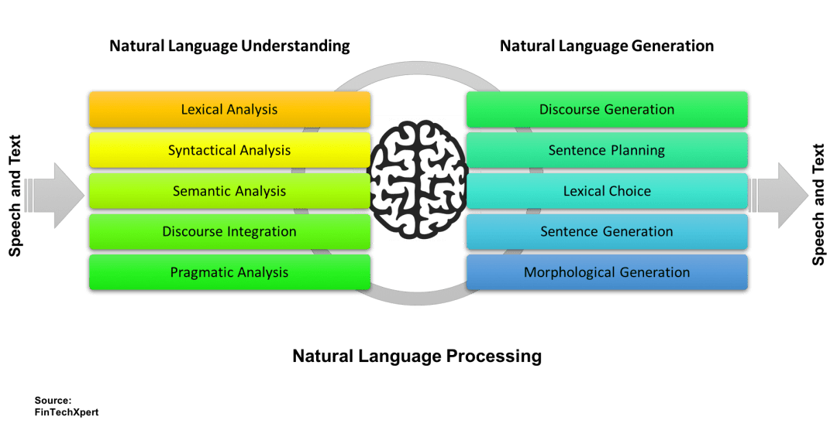

Slide 12


Slide 13
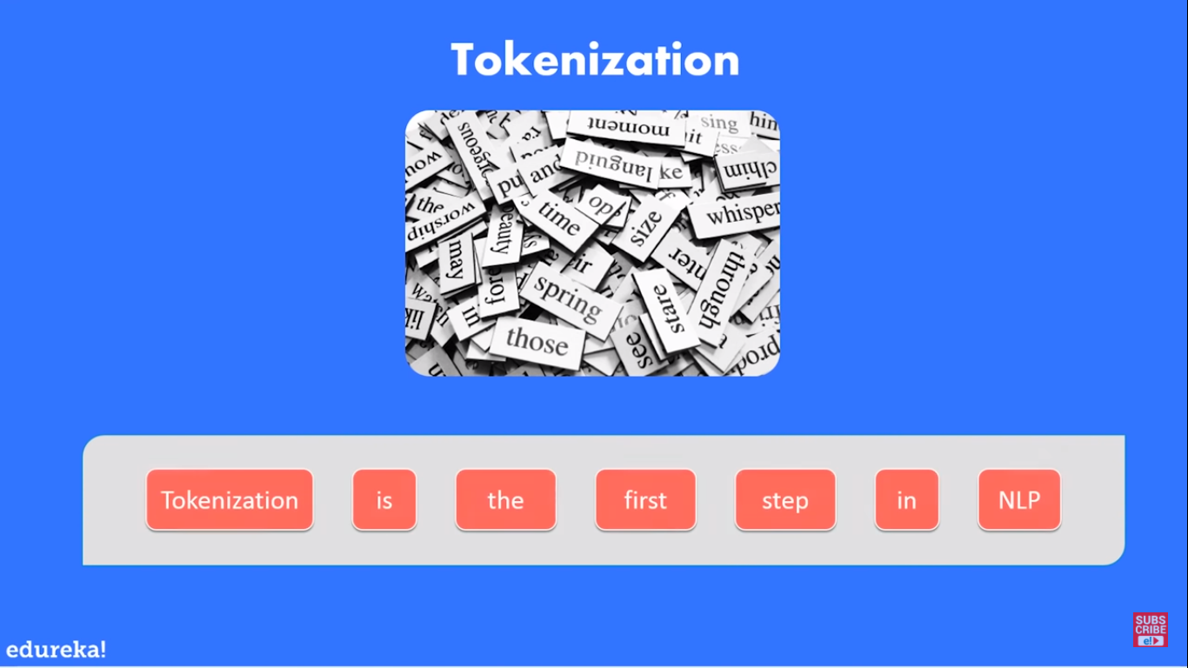

Slide 14
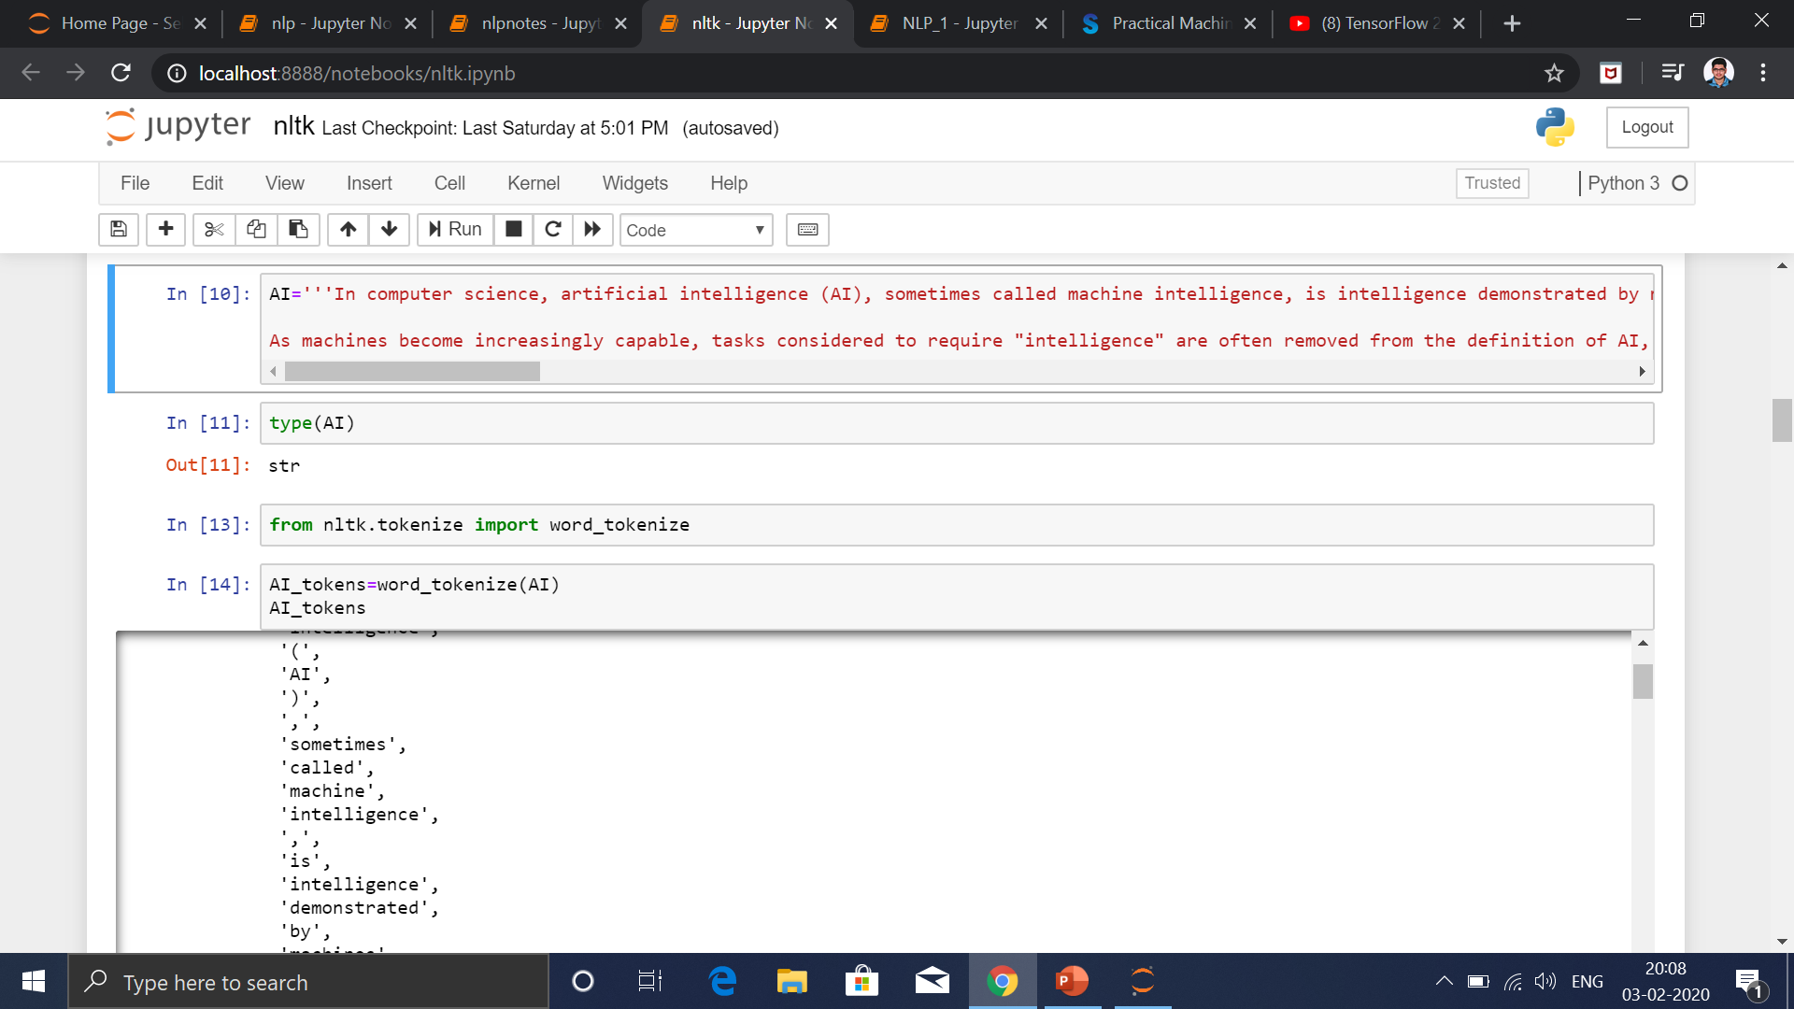

Slide 15
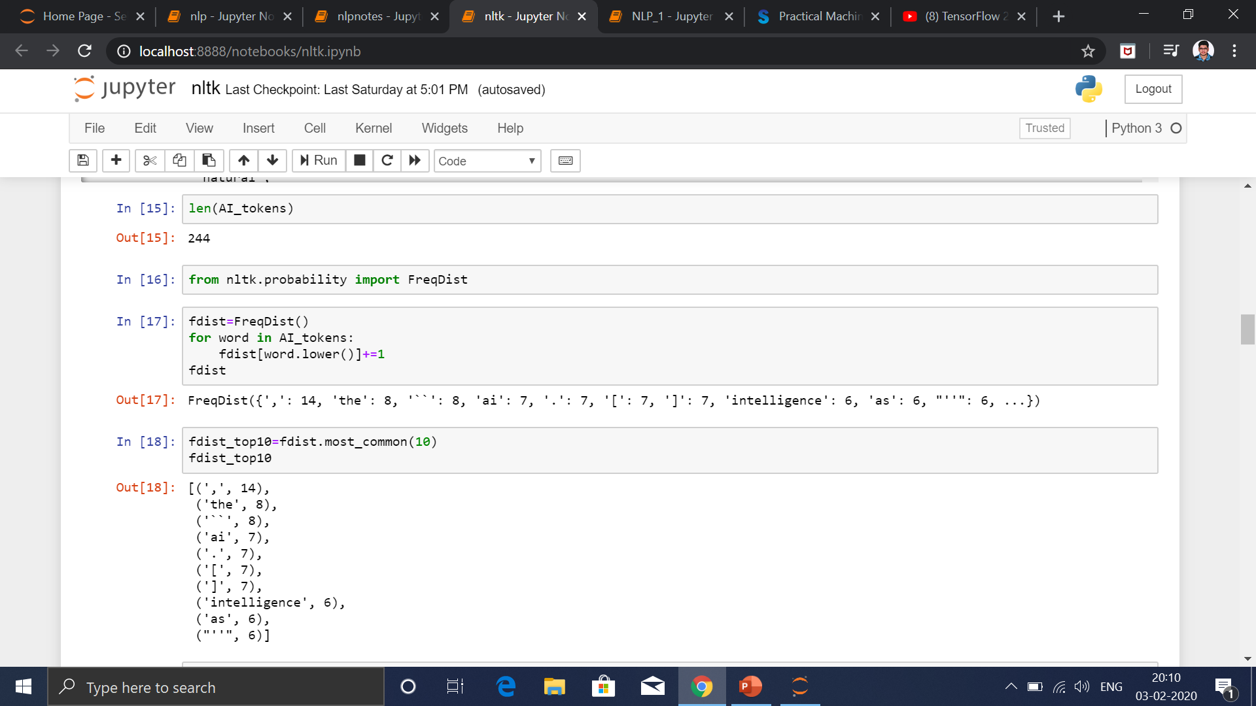

Slide 16
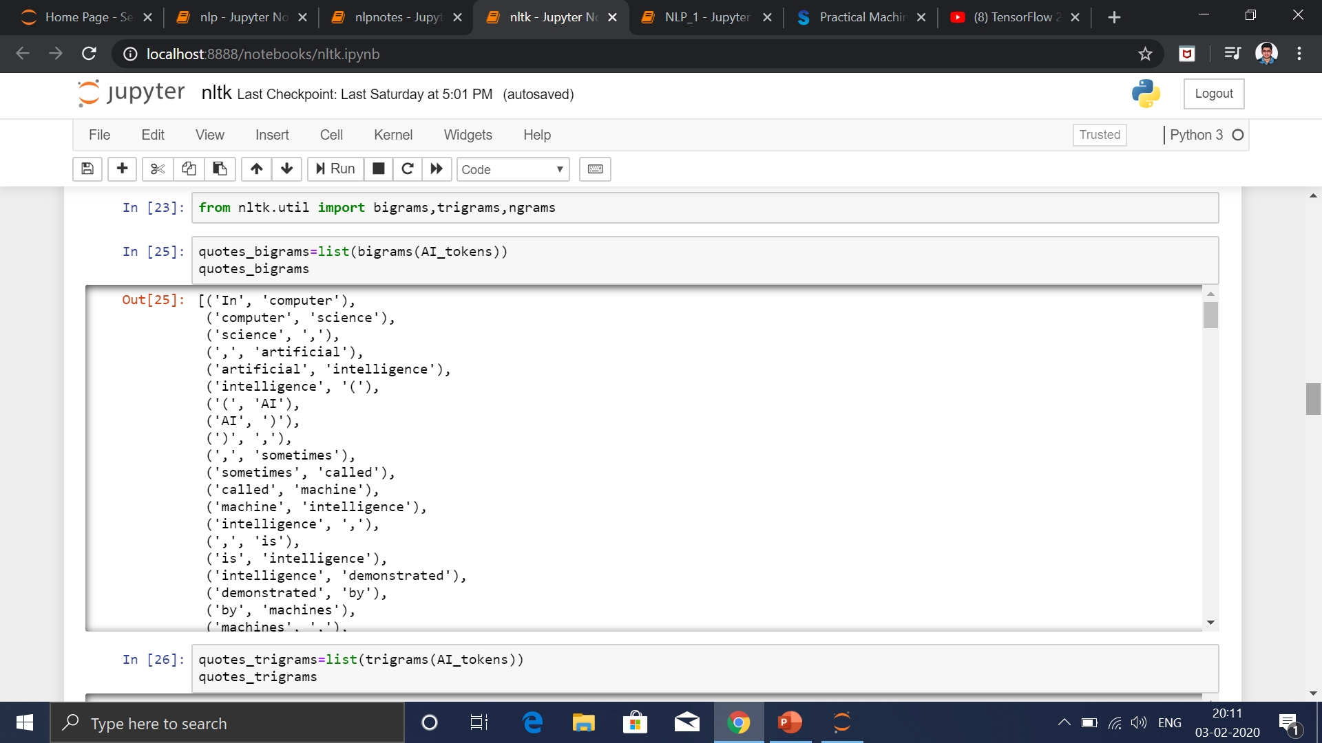

Slide 17
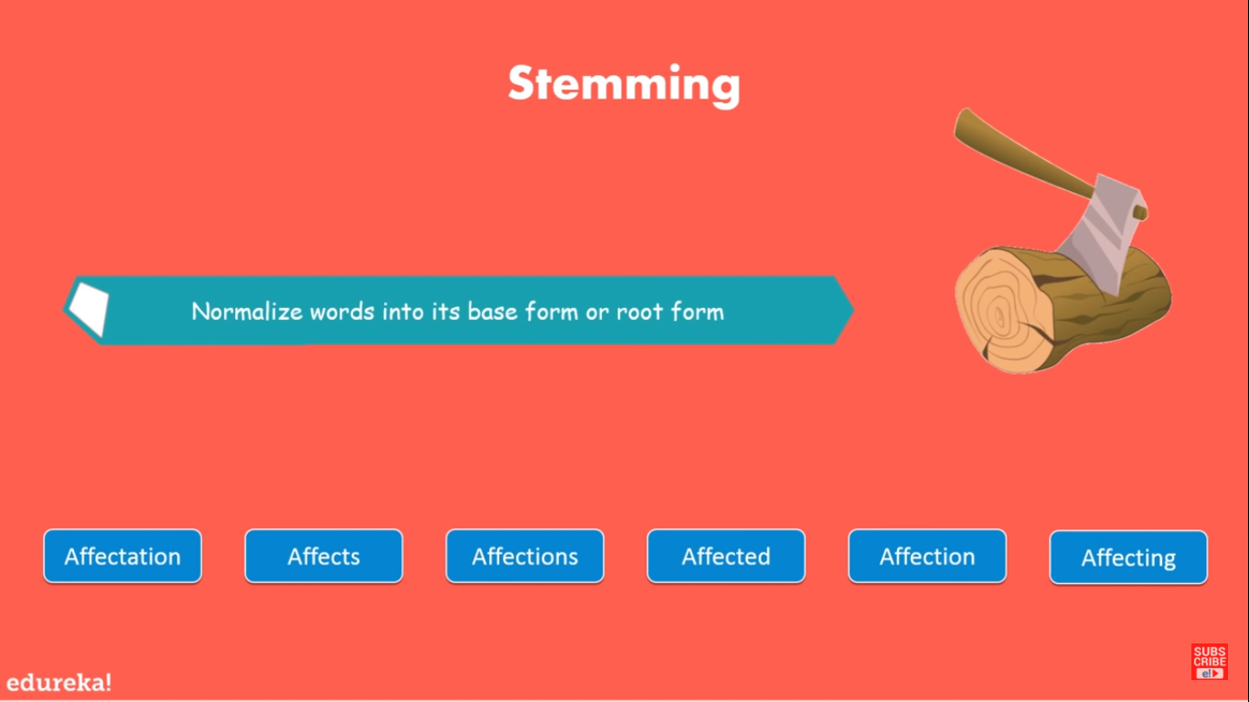
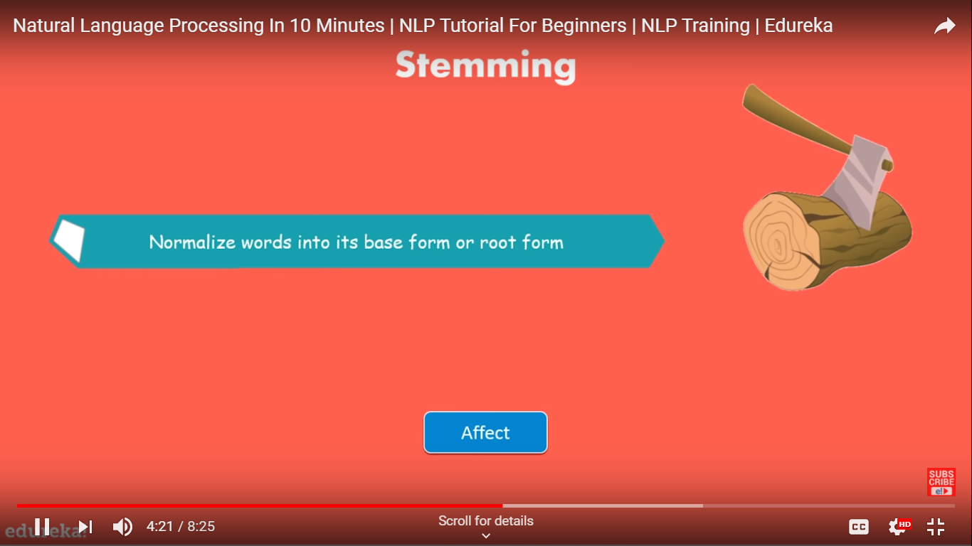

Slide 18
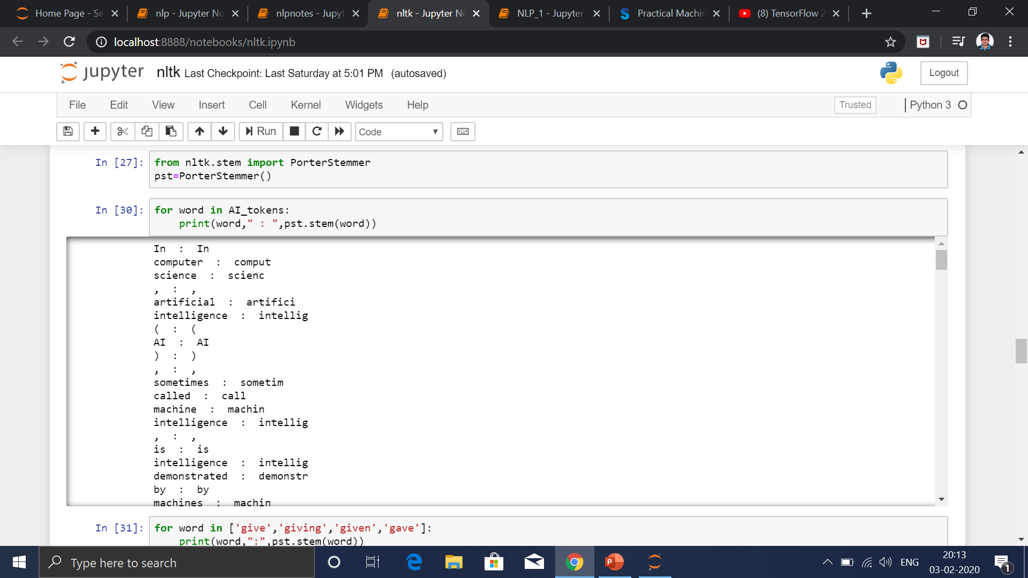

Slide 19
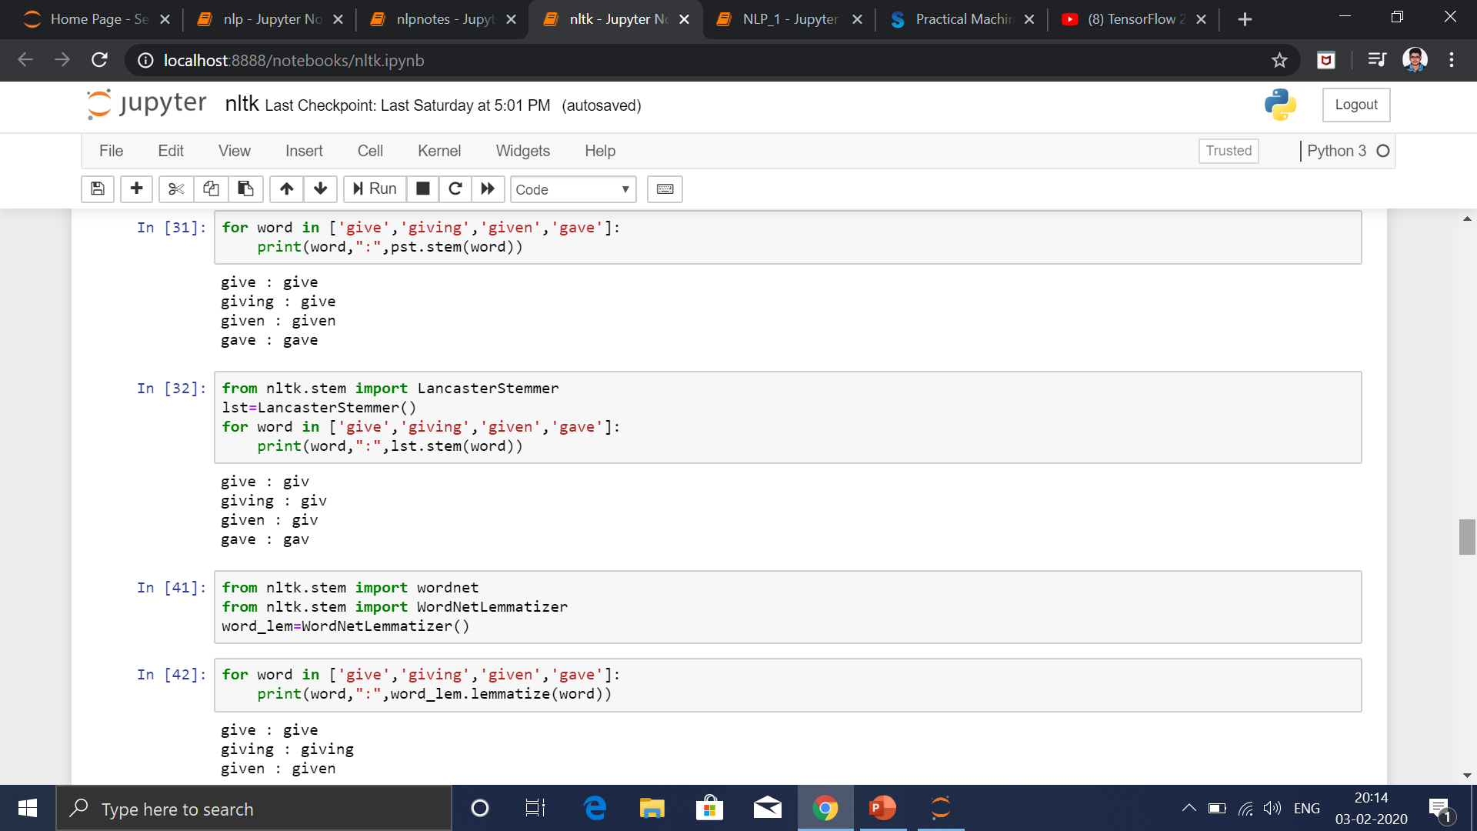

Slide 20
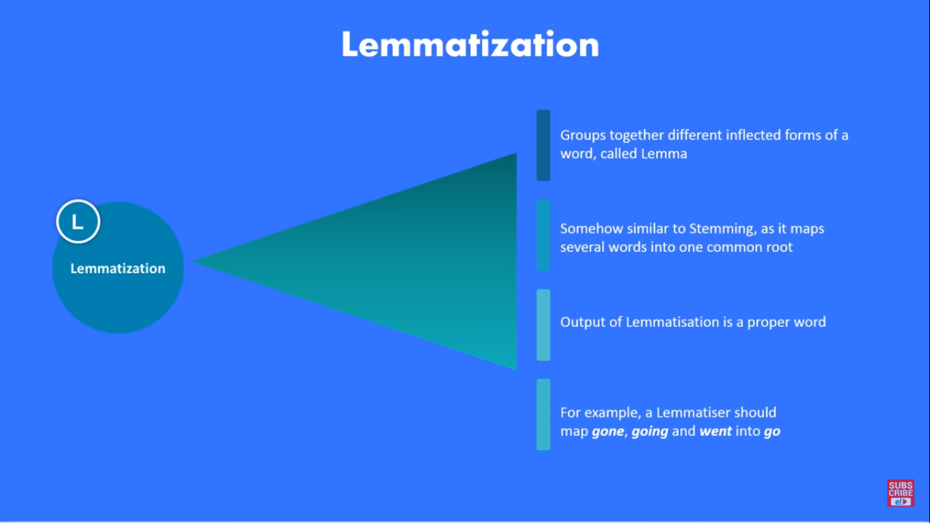

Slide 21
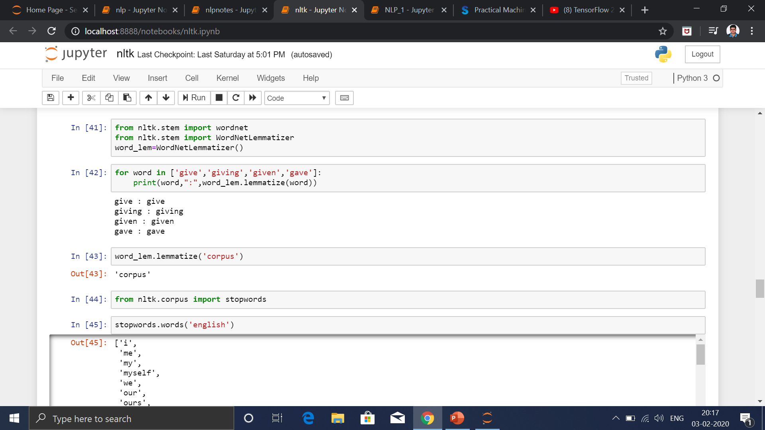

Slide 22
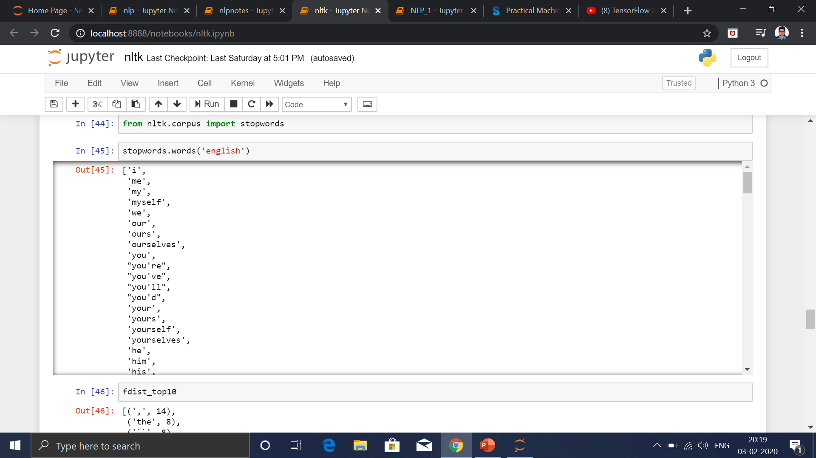
REMOVING OF STOP WORDS

Slide 23
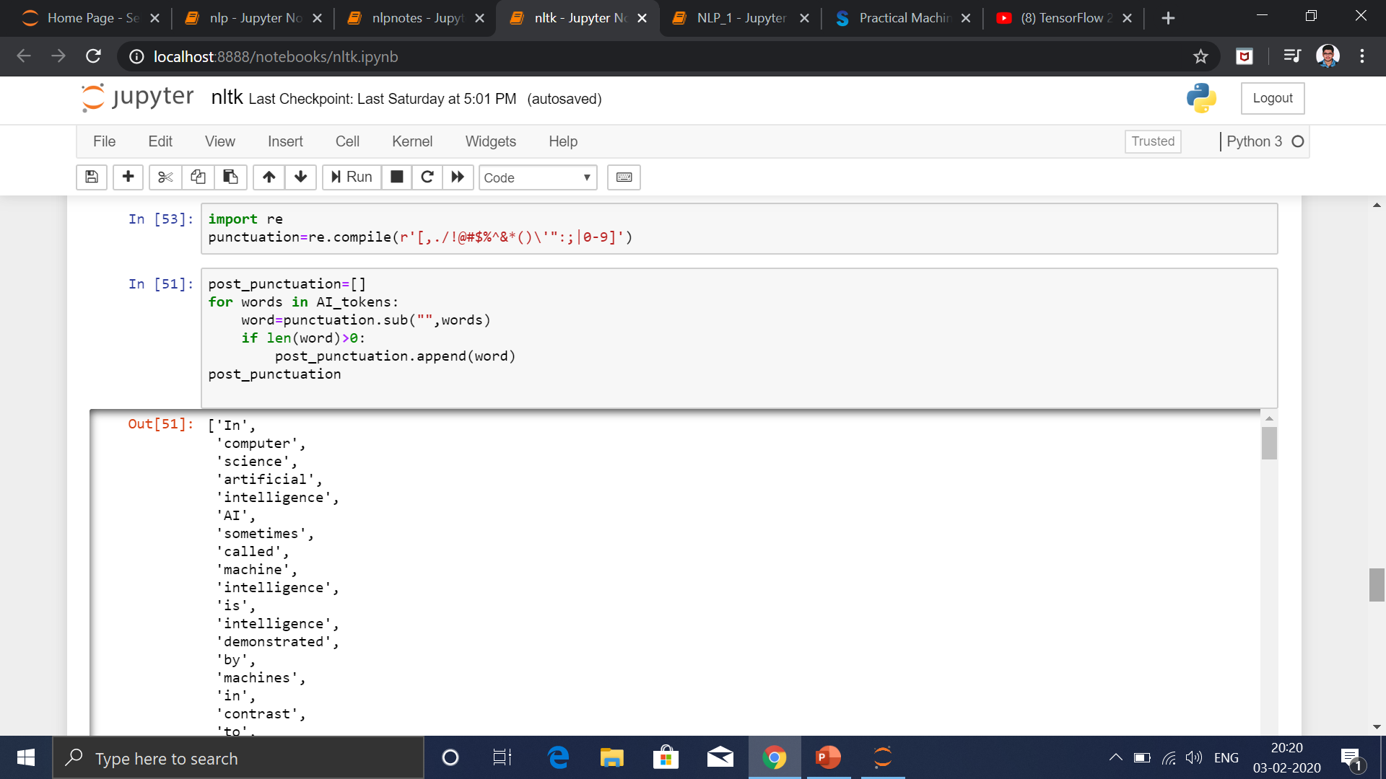

Slide 24
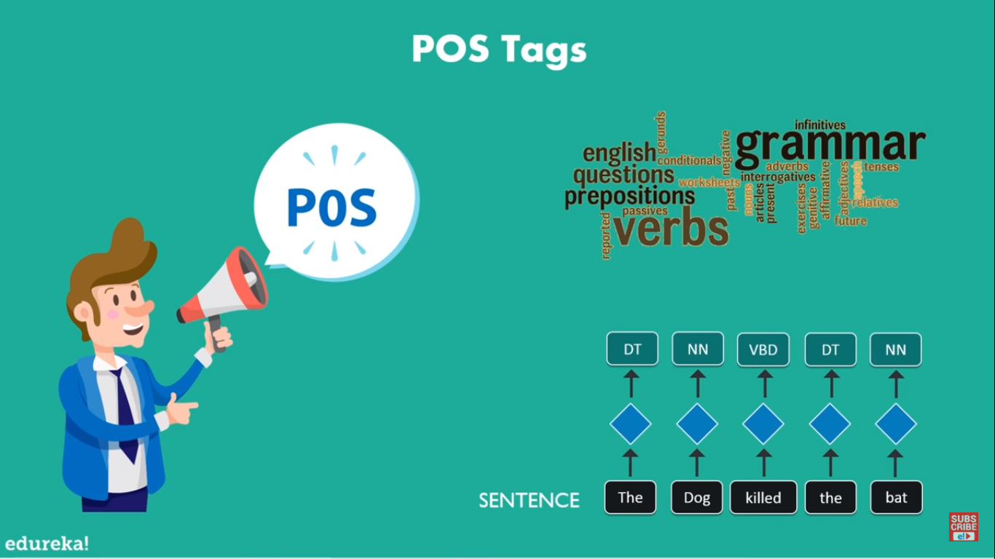

Slide 25
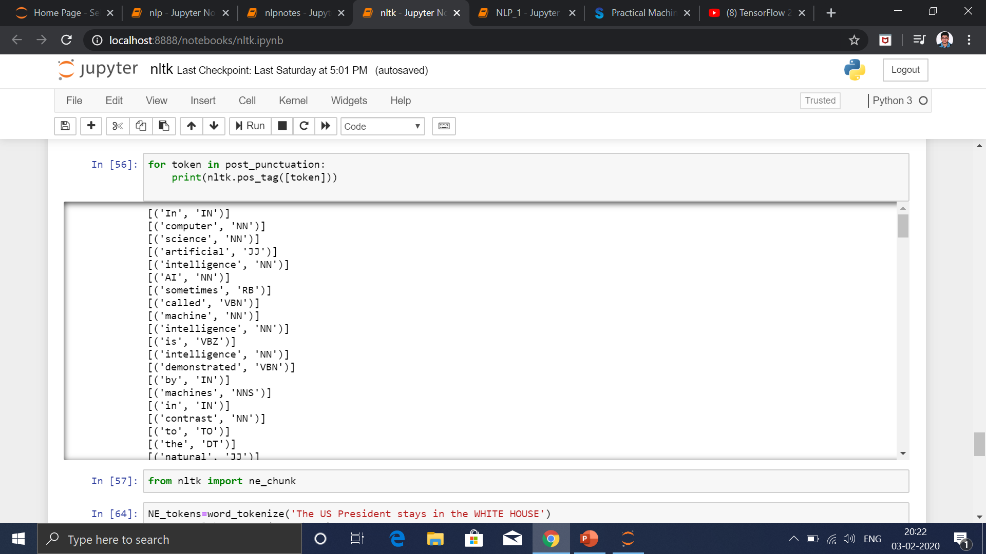

Slide 26


Slide 27
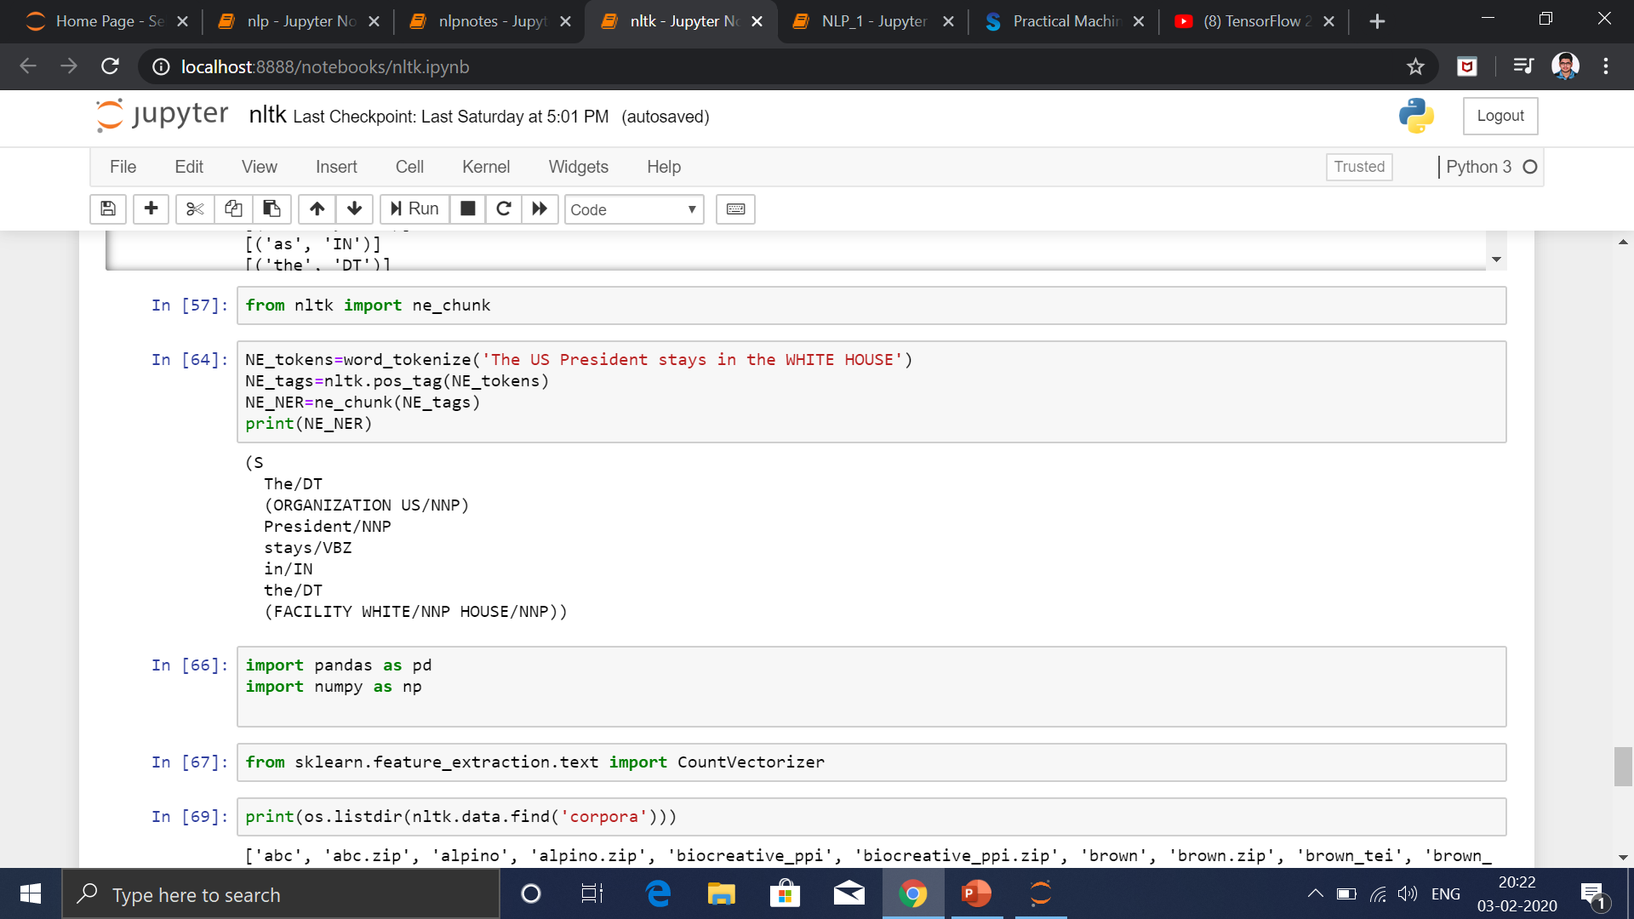

Slide 28
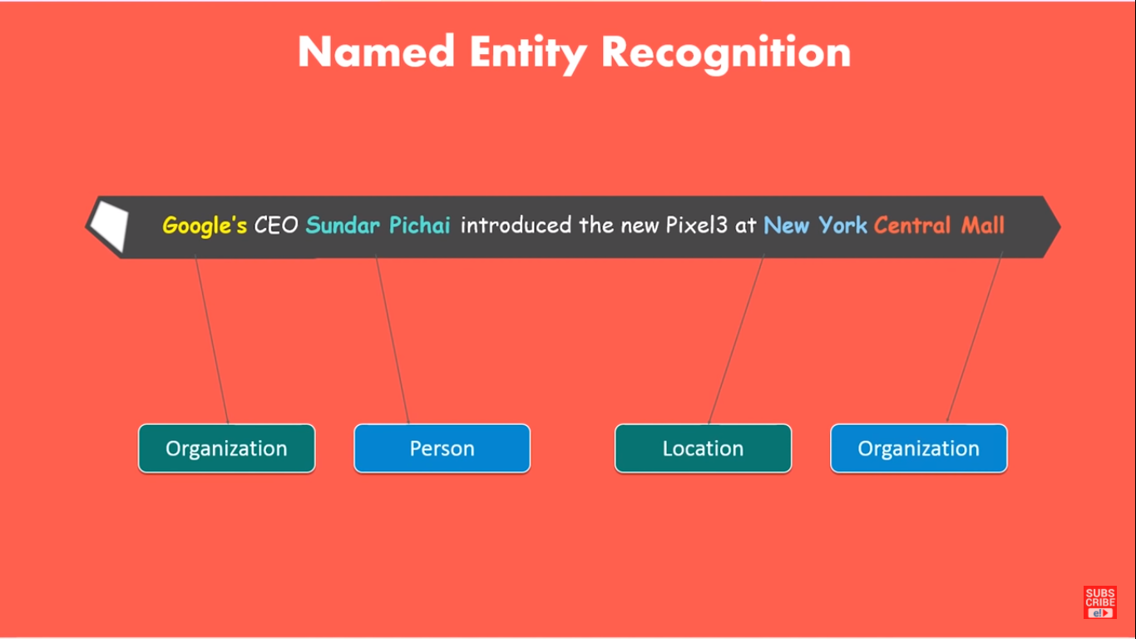

Slide 29
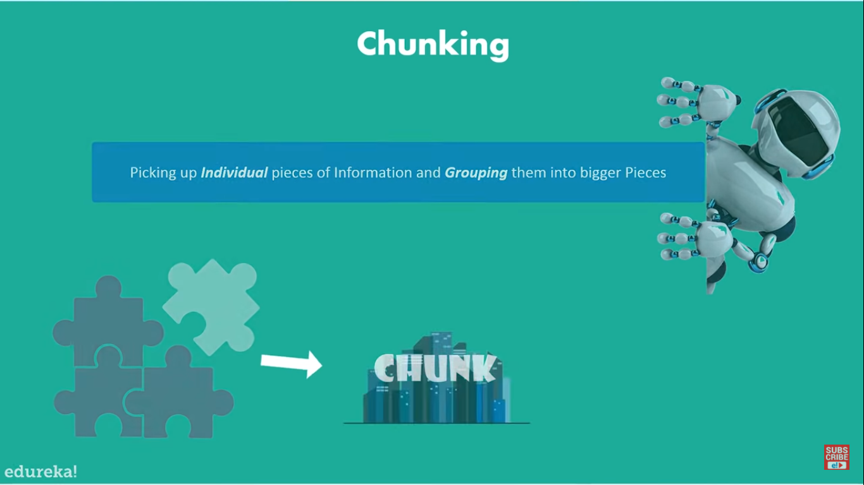

Slide 30
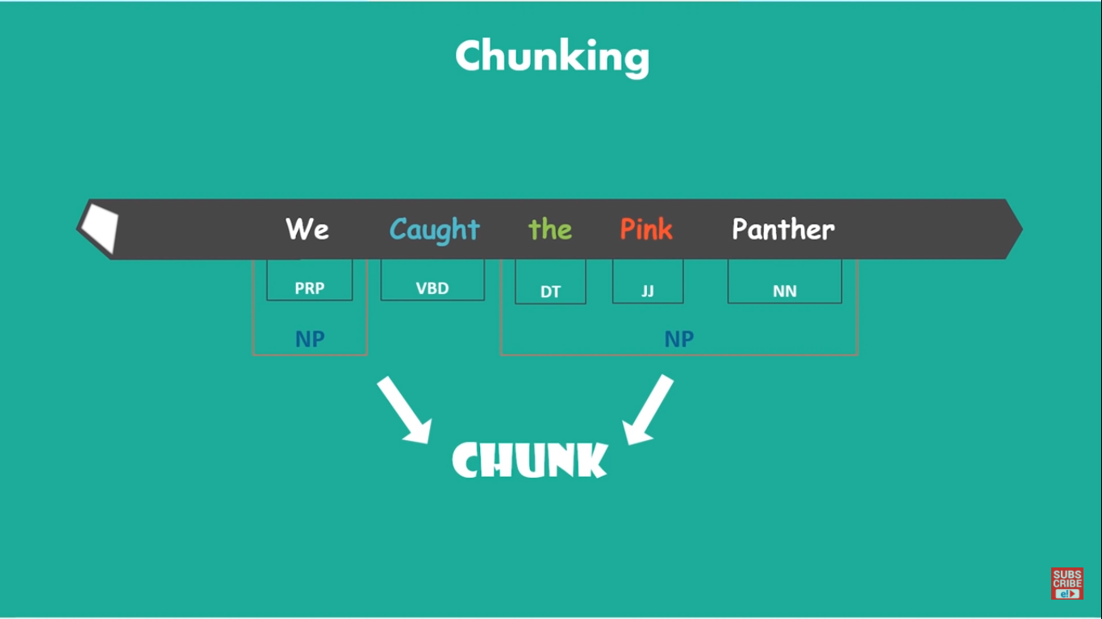

Slide 31
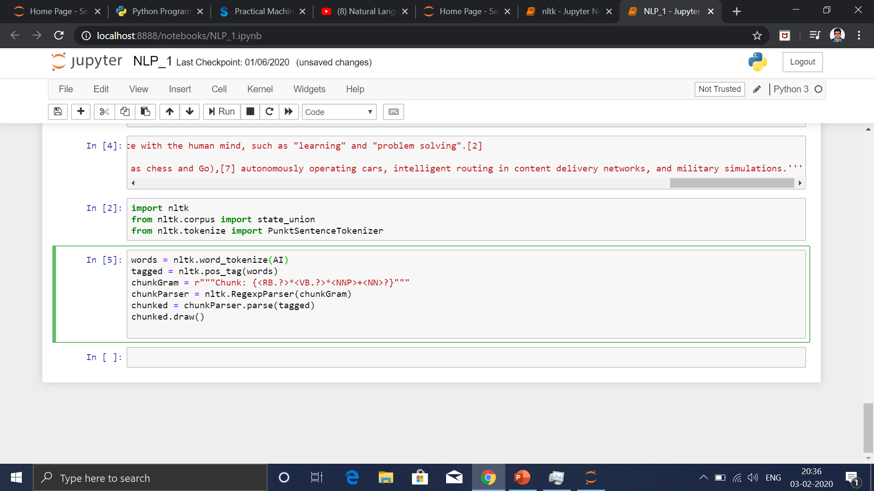

Slide 32
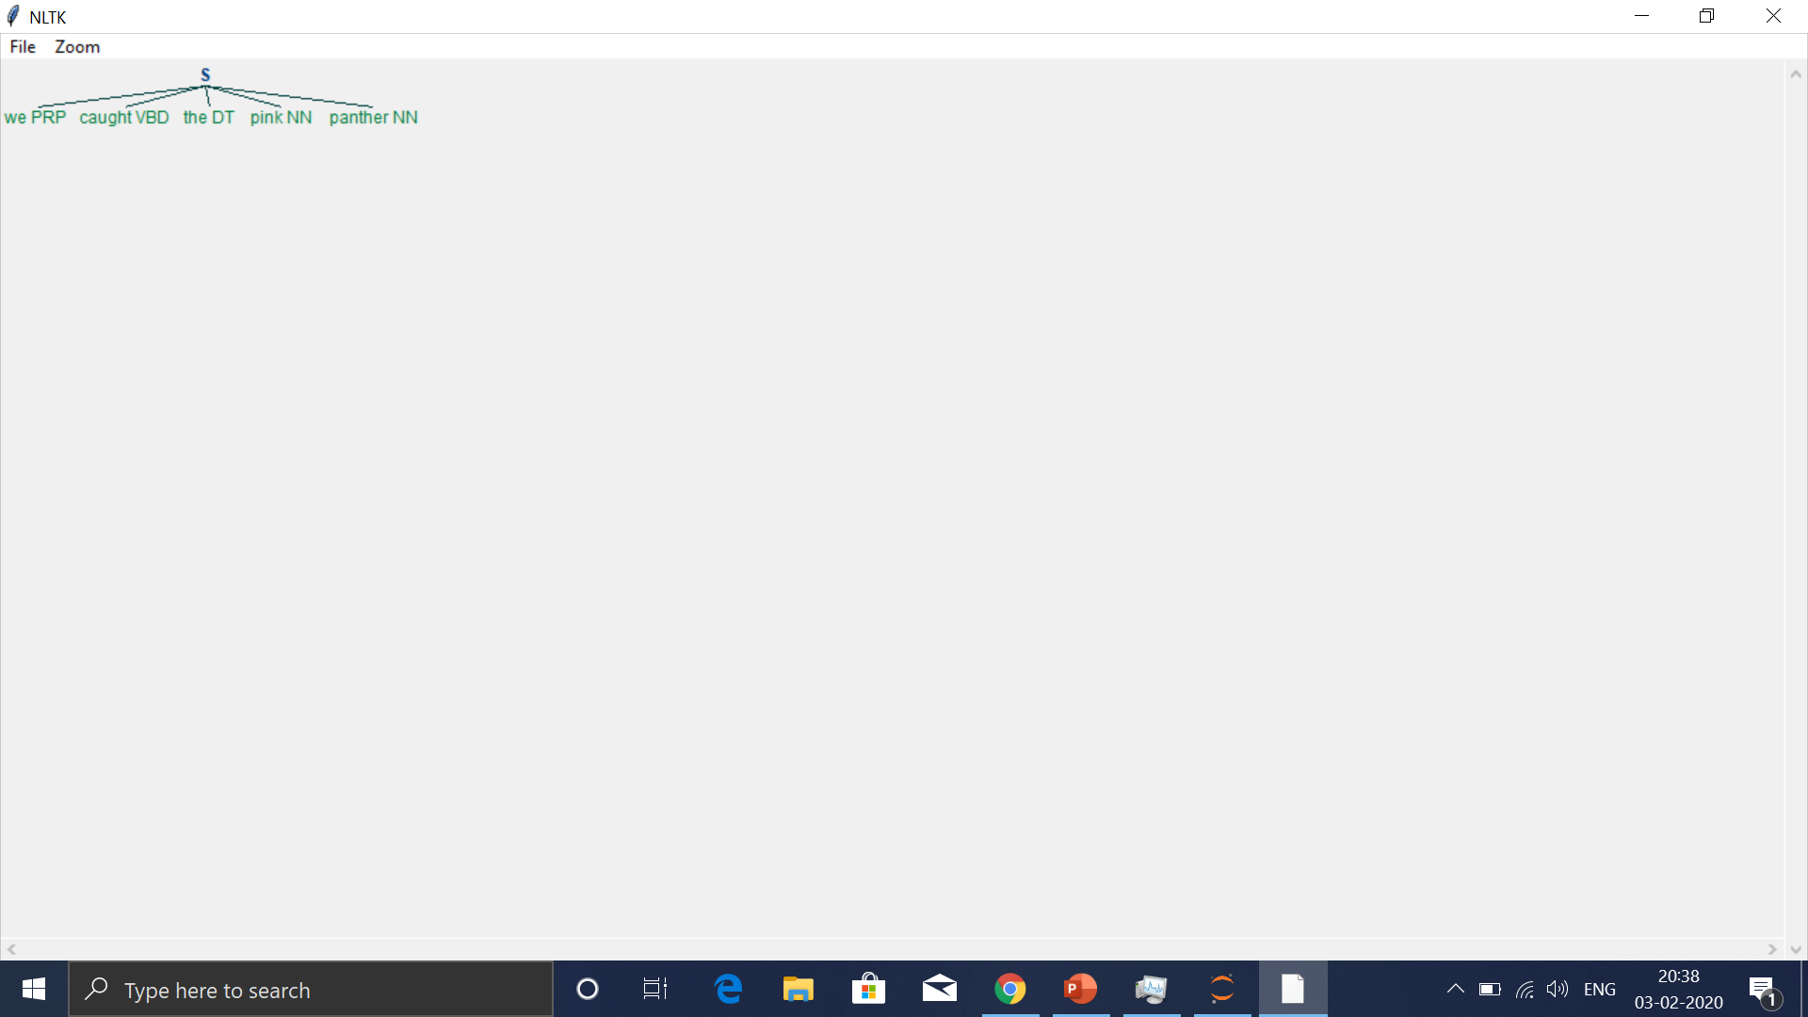

Slide 33
SENTIMENT ANALYSIS OF TWITTER
Sentiment Analysis means analyzing the sentiment of a given text or document and categorizing the text/document into a specific class or category (like positive and negative). In other words, we can say that sentiment analysis classifies any particular text or document as positive or negative. Basically, the classification is done for two classes: positive and negative. However, we can add more classes like neutral, highly positive, highly negative, etc.
Sentiment Analysis is also referred as Opinion Mining. It’s mostly used in social media and customer reviews data.

Slide 34
SUPERVISED CLASSIFICATION:
Here, we will be doing supervised text classification. In supervised
classification,the classifier is trained with labeled training data.
In this article, we will use the NLTK’s twitter_samples corpus as
our labeled training data.
The twitter_samples corpus contains 2K movie reviews with
sentiment polarity classification.
It’s compiled by Pang, Lee.
Here, we have two categories for classification. They
are: positive and negative. The twitter_samples corpus
already has the tweets categorized as positive and negative.
The twitter_samples corpus contains 3 files.
1) negative_tweets.json: contains 5k negative tweets 2) positive_tweets.json: contains 5k positive tweets 3) tweets.20150430-223406.json: contains 20k positive and
negative tweets

Slide 35
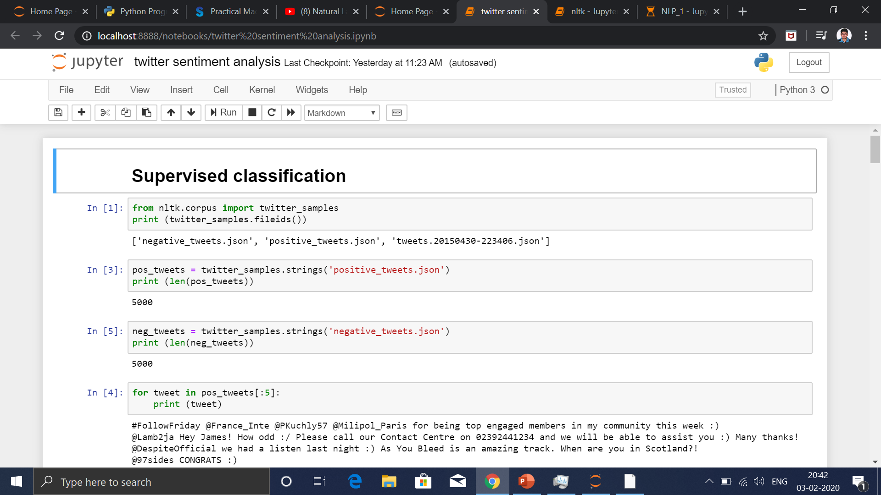

Slide 36
TOKENIZATION
NLTK has a TweetTokenizer module that does a good job in tokenizing (splitting text into a list of words) tweets.
Three different parameters can be passed while calling the TweetTokenizer class. They are:
preserve_case: if False then it converts tweet to lowercase and vice-versa. strip_handles: if True then it removes twitter handles from the tweet and vice-versa. reduce_len: if True then it reduces the length of words in the tweet like hurrayyyy, yipppiieeee, etc. and vice-versa.

Slide 37
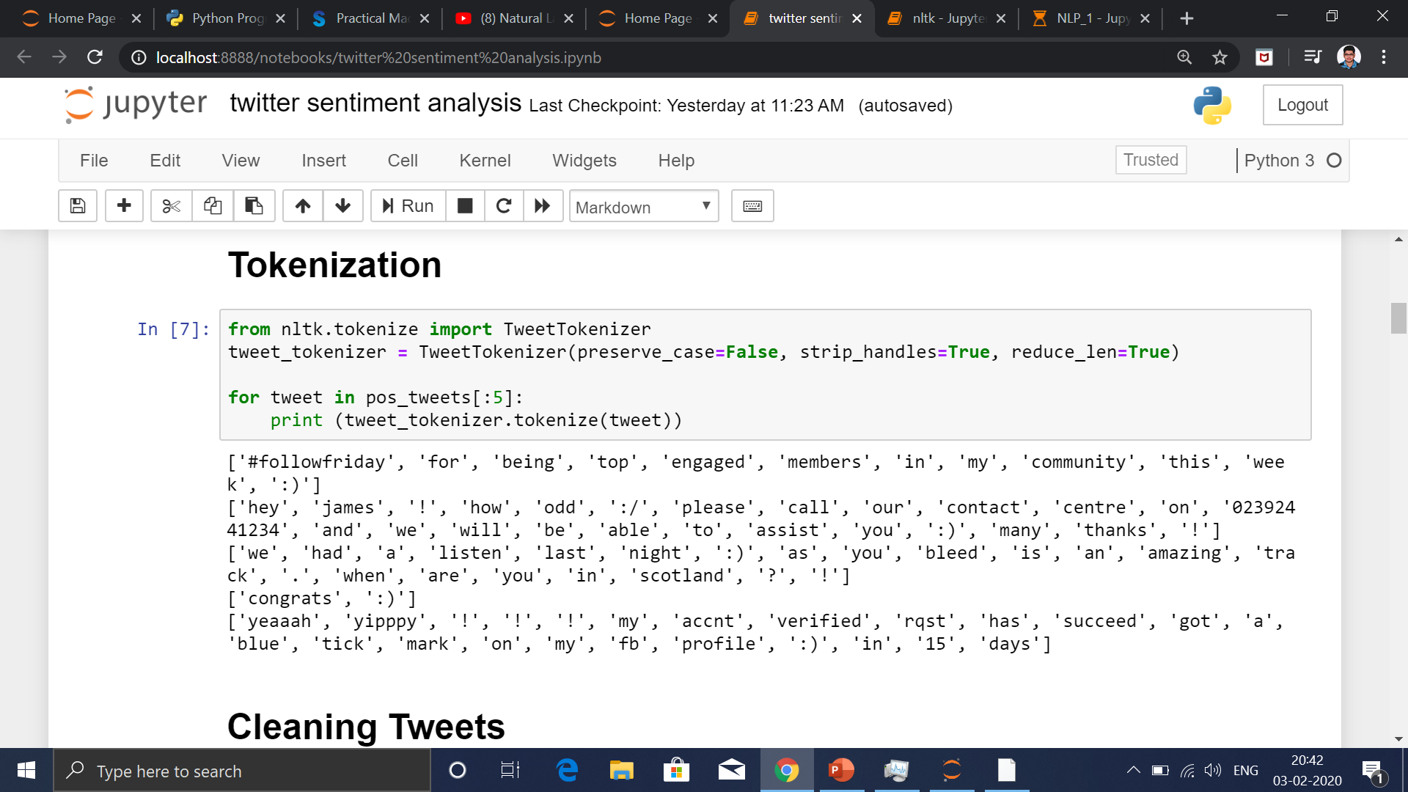

Slide 38
CLEANING TWEETS
In the tweet cleaning process, we will do the following:
– Remove stock market tickers like $GE – Remove retweet text “RT” – Remove hyperlinks – Remove hashtags (only the hashtag # and not the word) – Remove stop words like a, and, the, is, are, etc. – Remove emoticons like :), :D, :(, :-), etc. – Remove punctuation like full-stop, comma, exclamation sign, etc. – Convert words to Stem/Base words using Porter Stemming Algorithm.
E.g. words like ‘working’,
‘works’, and ‘worked’ will be converted to their base/stem word “work”.

Slide 39
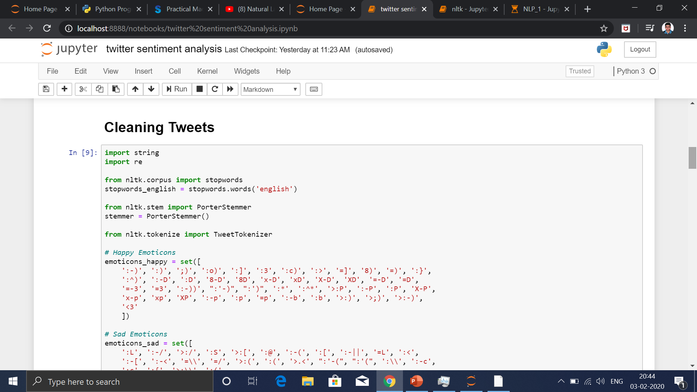

Slide 40
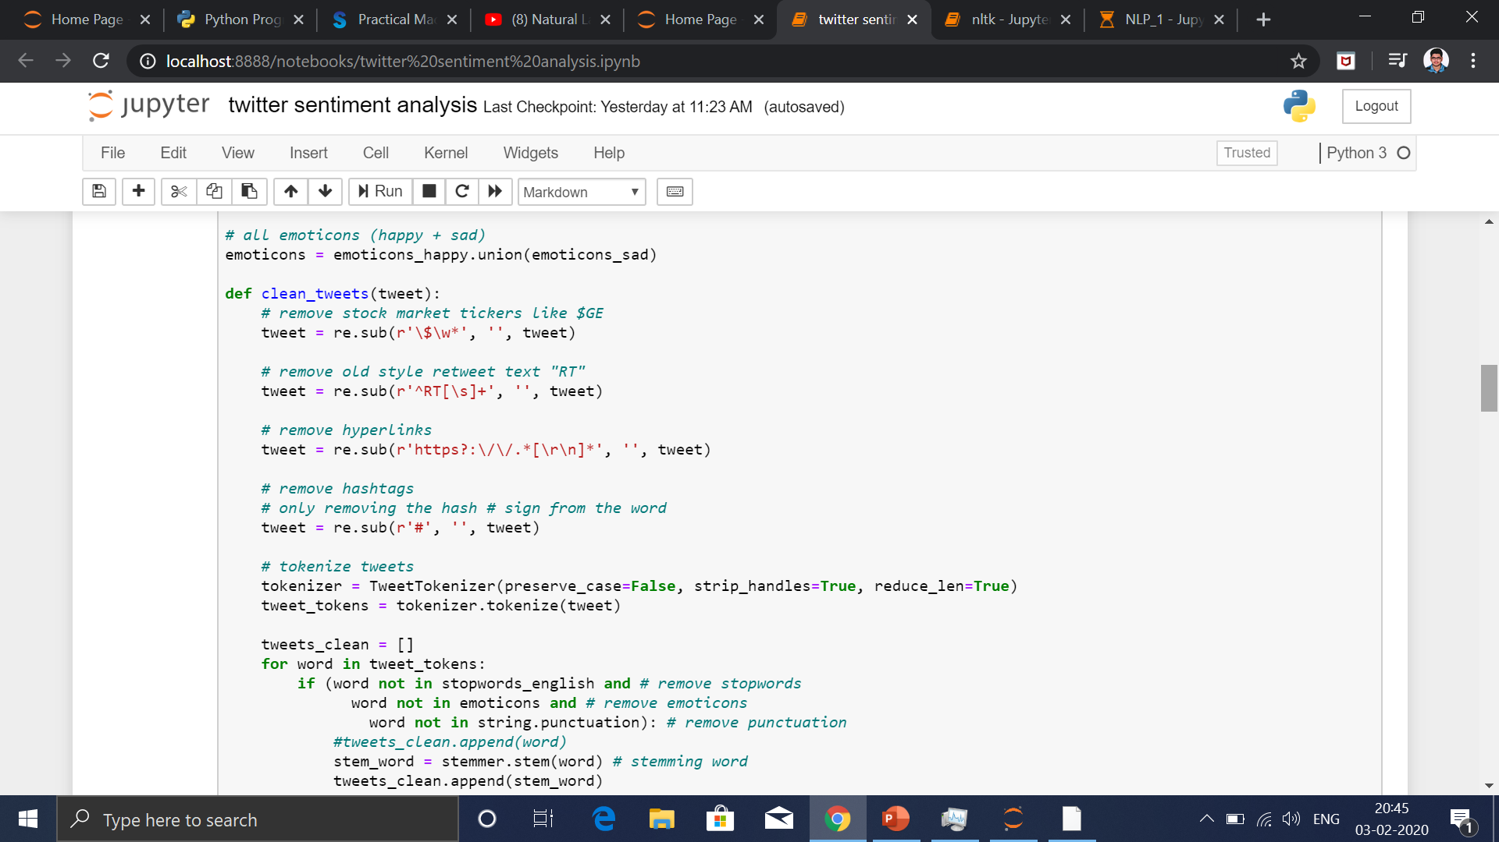

Slide 41
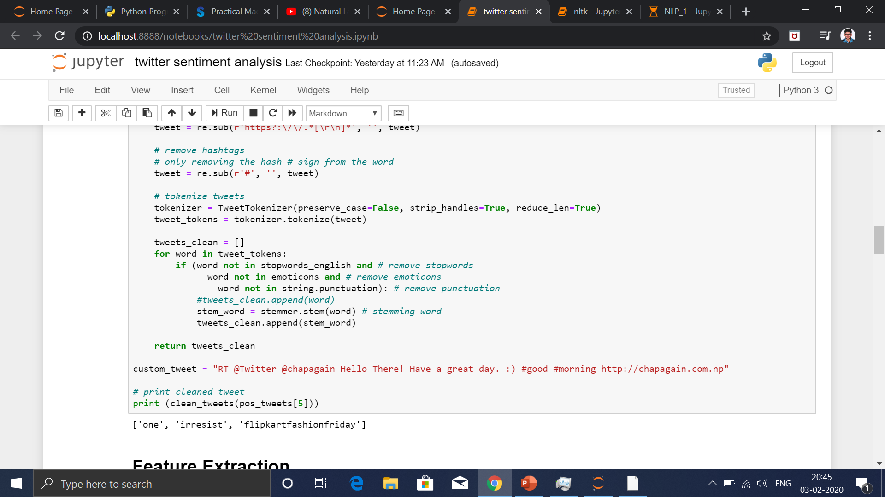

Slide 42
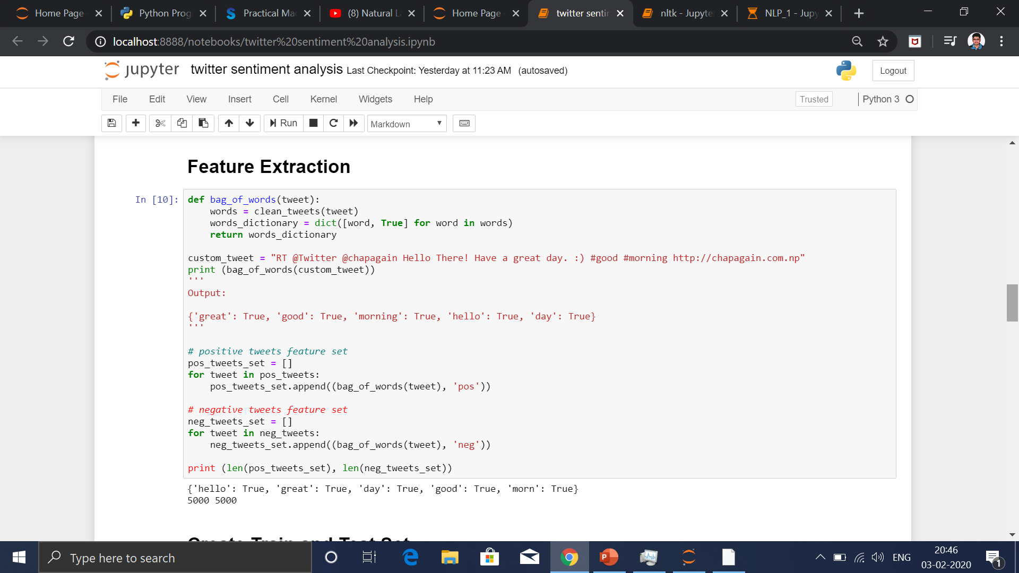
Feature Extraction

Slide 43
NAÏVE BAYES CLASSIFIER
Naive Bayes Classifiers rely on the Bayes’ Theorem, which is based on conditional probability or in simple terms, the likelihood that an event (A) will happen given that another event (B) has already happened. Essentially, the theorem allows a hypothesis to be updated each time new evidence is introduced. The equation below expresses Bayes’ Theorem in the language of probability:
P(A|B)=P(B|A) x P(A)
P(B)

Slide 44
Let’s explain what each of these terms means.
“P” is the symbol to denote probability.
P(A | B) = The probability of event A (hypothesis) occurring given that B (evidence) has occurred.
P(B | A) = The probability of the event B (evidence) occurring given that A (hypothesis) has occurred.
P(A) = The probability of event B (hypothesis) occurring.
P(B) = The probability of event A (evidence) occurring.

Slide 45
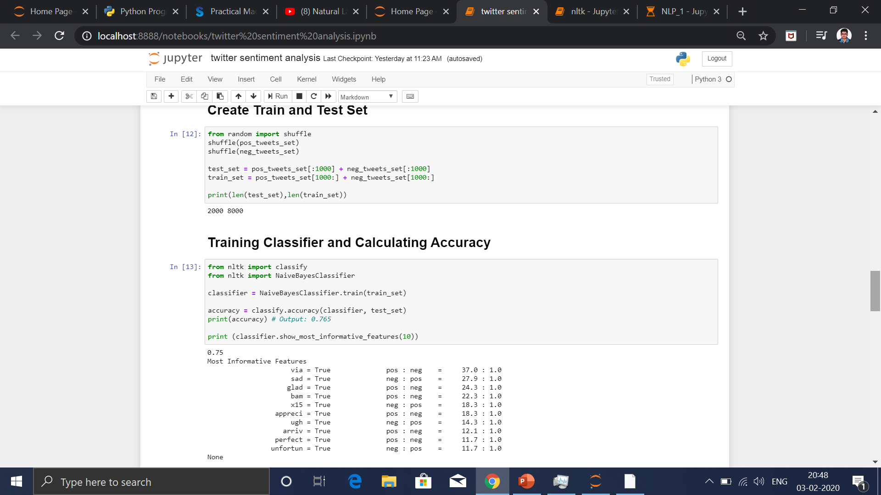

Slide 46
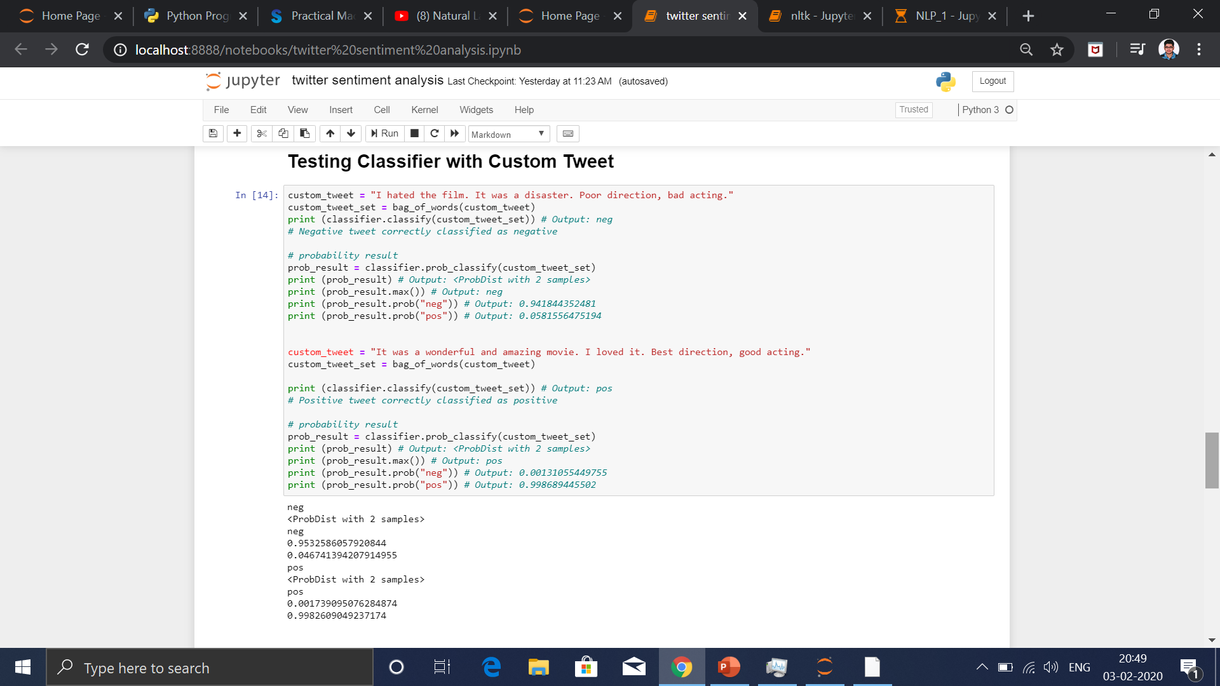

Slide 47
Precision, Recall & F1-Score
Accuracy is (correctly predicted observation) / (total observation).
Precision is about being precise. – It shows how many correct predictions were given. – For example, out of 100 questions, if you answered only
1 question and answered it correctly then you will have 100% precision. – It’s about checking how often the classifier predicts the result correctly.
Recall (as opposed to precision) – is about answering all questions that have the answer “true” with the answer “true”. – It’s about checking how often does the classifier predicts “yes” when the result is
actually “yes”.
F1 Score or F-measure: Harmonic mean of recall and precision.

Slide 48
We should have “true” answers and “false” answers for the calculation of precision and recall.
For mathematical representation of precision and recall, we need to understand the following:
True Positive (TP): e.g. the number of patients who did have cancer whom
we correctly diagnosed as having cancer True Negative (TN): e.g. the number of patients who did not have cancer whom
we correctly diagnosed as not having cancer
False Positive (FP): e.g. the number of patients who did not have cancer whom
we incorrectly diagnosed as having cancer (Also known as Type I error) False Negative (FN): e.g. the number of patients who did have cancer whom
we incorrectly diagnosed as not having cancer (Also known as Type II error)
Accuracy = (TP + TN) / (TP + TN + FP + FN)
Precision = (TP) / (TP + FP)
Recall = (TP) / (TP + FN)
F1 Score = 2 * (precision * recall) / (precision + recall)

Slide 49
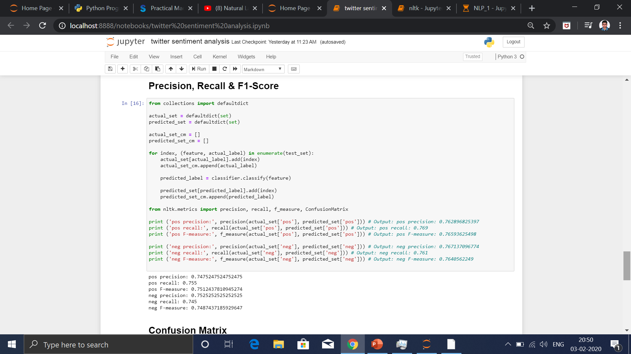

Slide 50
